Slide 1
Convolutional Neural Networks II

Slide 2
Outline
Recap
Training CNNs
What Activation Functions do we use?
What is Pooling?
Dense Layers

Slide 3
Outline
Recap
Training CNNs
What Activation Functions do we use?
What is Pooling?
Dense Layers

Slide 4

A Convolutional Network
+ ReLU
Why is there more than one layer?
+ ReLU
What is this square?
What are feature maps and why are there multiple feature maps?
What is going on here?
What is Pooling?

Slide 5

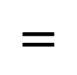
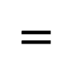
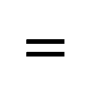
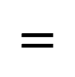
Grayscale
$$∗$$
0.0625 0.125 0.0625
0.125 0.25 0.125
0.0625 0.125 0.0625
0 -1 0
-1 20 -1
0 -1 0
-3 0 3
-6 0 6
-3 0 3
-3 -6 -3
0 0 0
3 6 3
$$=$$
$$=$$
$$=$$
$$=$$
BLURRING
SHARPENING
VERTICAL LINES
HORIZONTAL LINES

Slide 6
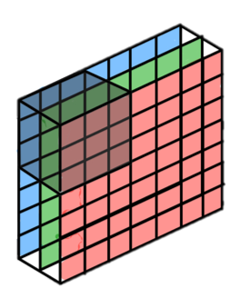
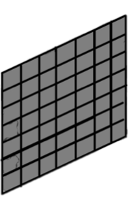
Basics of CNNs
input
output layer
hidden layer 1
hidden layer 2
MLP
CNN
CNNs are composed of layers, but those layers are not fully connected: they have filters, sets of cube-shaped weights, that are applied throughout the image.
Each 2D slice of a filter is called kernel.
These filters introduce translation invariance and parameter sharing.
How are they applied? Convolution!

Slide 7
What are the dimensions of filters, and how do we apply them from one layer to the next?

Slide 8
Example: A convolutional layer with one 3x3 filter that takes an 32x32 RGB image as input.
Input
size=32X32
channels=3
1 Filter
size=3x3X3
stride = 1
padding = same
Output
size=32X32
How many parameters does the layer have?

Slide 9
Example 2: A convolutional layer with 16 3x3 filters that takes 32x32 RGB image as input.
A convolutional layer with 16 3x3 filters that takes 32x32 RGB image as input.
How many parameters does the layer have?

Slide 10
Example 2: A convolutional layer with 16 3x3 filters that takes 32x32 RGB image as input.
A convolutional layer with 16 3x3 filters that takes 32x32 RGB image as input.
How many parameters does the layer have?
16
Number of filters

Slide 11
Example 2: A convolutional layer with 16 3x3 filters that takes 32x32 RGB image as input.
A convolutional layer with 16 3x3 filters that takes 32x32 RGB image as input.
How many parameters does the layer have?
16 x 3 x 3
Number of filters
Size of Filters

Slide 12
Example 2: A convolutional layer with 16 3x3 filters that takes 32x32 RGB image as input.
A convolutional layer with 16 3x3 filters that takes 32x32 RGB image as input.
How many parameters does the layer have?
16 x 3 x 3 x 3
Number of filters
Size of Filters
Number of channels of prev layer

Slide 13
Example 2: A convolutional layer with 16 3x3 filters that takes 32x32 RGB image as input.
A convolutional layer with 16 3x3 filters that takes 32x32 RGB image as input.
How many parameters does the layer have?
16 x 3 x 3 x 3 +16
Number of filters
Size of Filters
Number of channels of prev layer
Biases (one per filter)

Slide 14
Example 2: A convolutional layer with 16 3x3 filters that takes 32x32 RGB image as input.
A convolutional layer with 16 3x3 filters that takes 32x32 RGB image as input.
How many parameters does the layer have?
16 x 3 x 3 x 3 +16 = 448
Number of filters
Size of Filters
Number of channels of prev layer
Biases (one per filter)

Slide 15
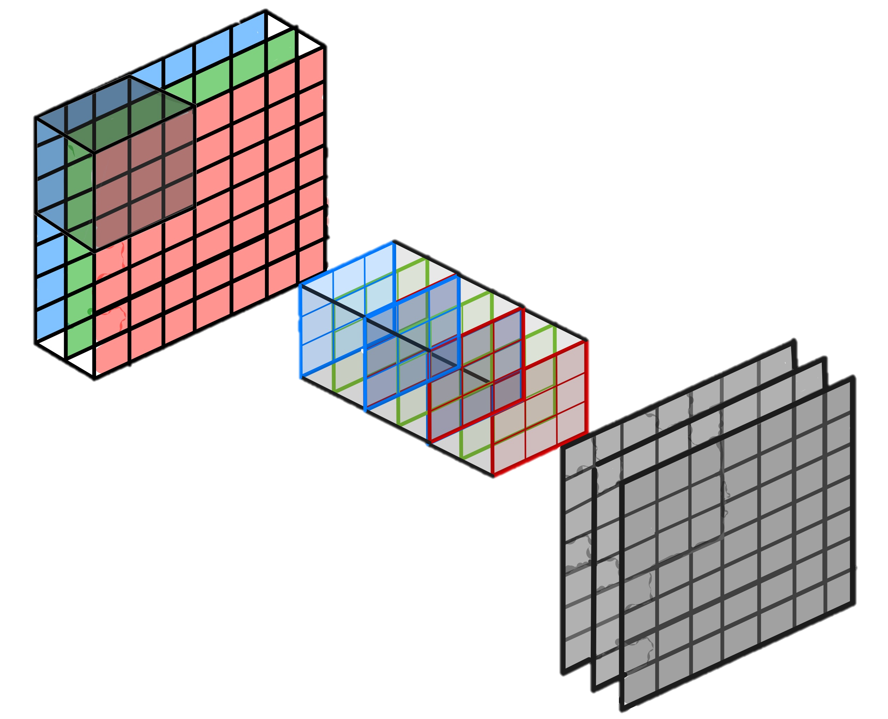
Convolutional layers (cont.)
To be clear: each filter is convolved with the entirety of the 3D input cube but generates a 2D feature map.
Because we have multiple filters, we end up with a 3D output: one 2D feature map per filter.
The feature map dimension can change drastically from one conv layer to the next: we can enter a layer with a 32x32x16 input and exit with a 32x32x128 output if that layer has 128 filters.
Convolution Filters
Feature Maps

Slide 16
Outline
Recap
Training CNNs
What Activation Functions do we use?
What is Pooling?
Dense Layers

Slide 17
Training CNN
In a convolutional layer, we are basically applying multiple filters over the image to extract different features.
But most importantly, we are learning those filters!

Slide 18
Training CNN
In a convolutional layer, we are basically applying multiple filters over the image to extract different features.
But most importantly, we are learning those filters!
HOW? We use BackProp and SGD as we did with FCNN

Slide 19
Training CNN
In a convolutional layer, we are basically applying multiple filters over the image to extract different features.
But most importantly, we are learning those filters!
One thing we’re missing: non-linearity.
HOW? We use BackProp and SGD as we did with FCNN

Slide 20
Outline
Recap
Training CNNs
What Activation Functions do we use?
What is Pooling?
Dense Layers

Slide 21
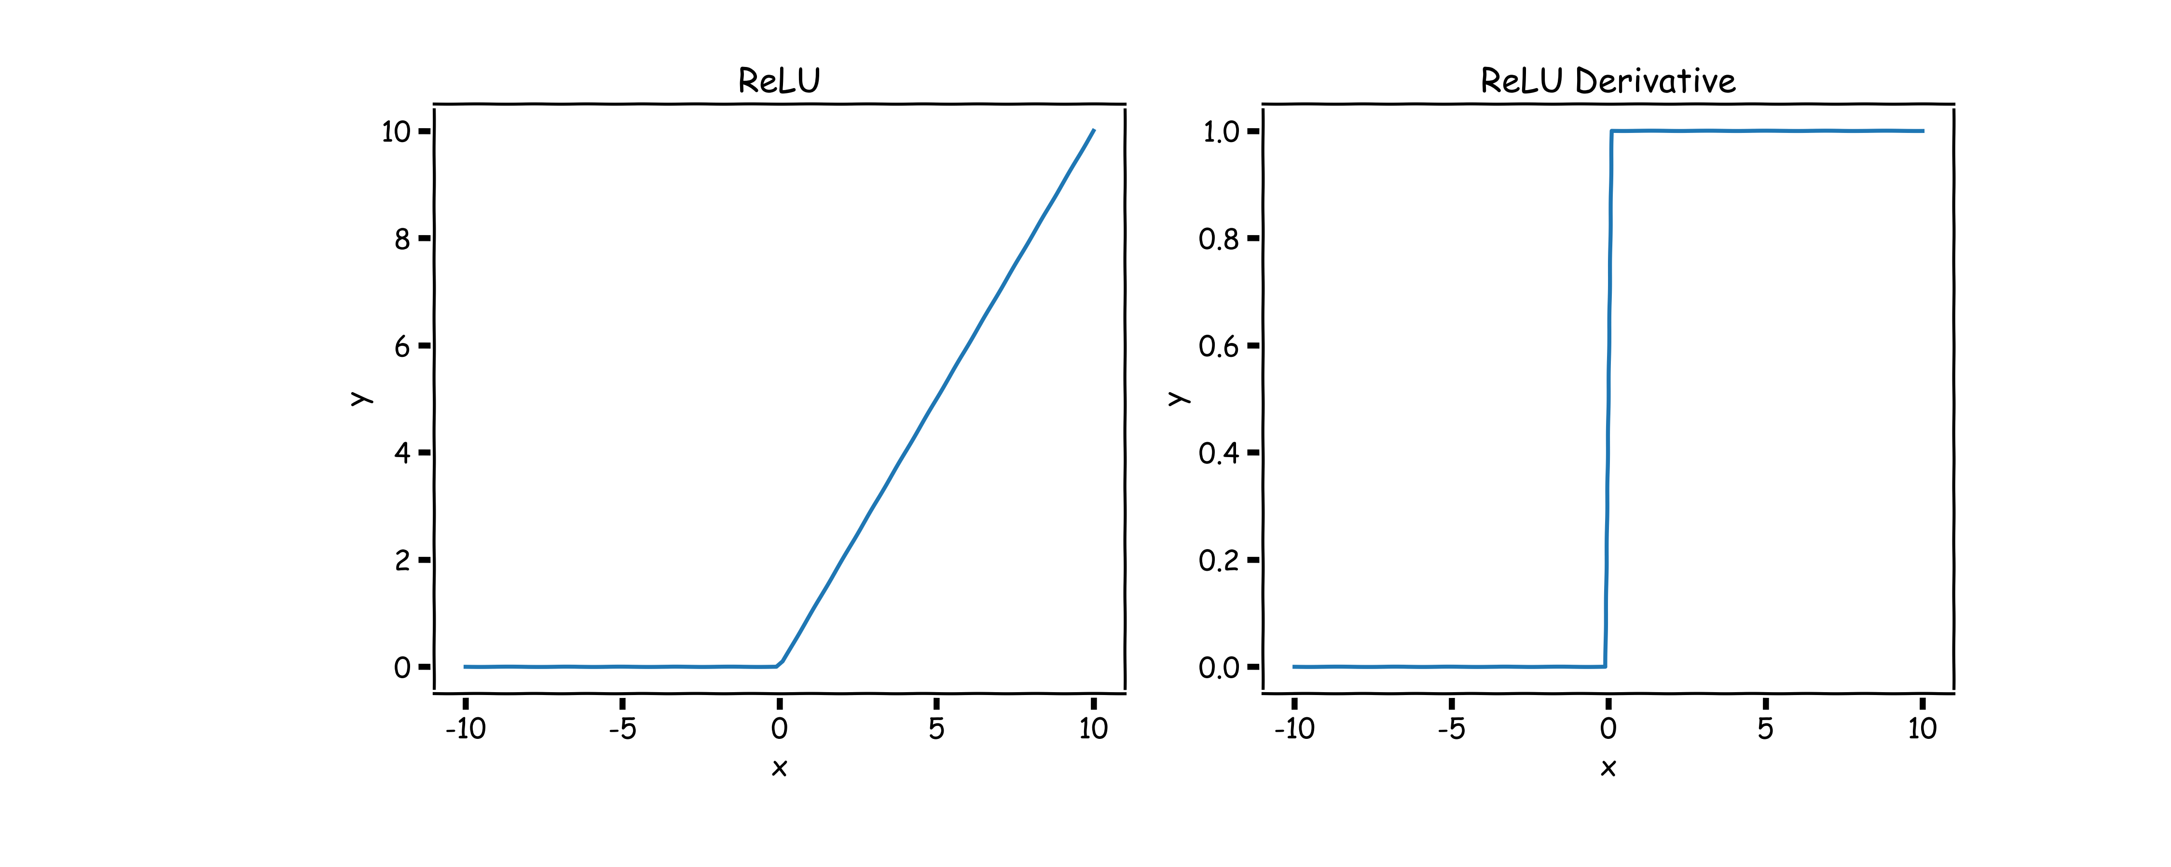
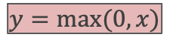
ReLU
We apply non-linear activation after convolution as we did for FCNN.
The most successful non-linear activation function for CNNs is the Rectified Non-Linear unit (ReLU):
This combats the vanishing gradient problem occurring in sigmoid, it is easier to compute, and generates sparsity.
$$y=max⁡(0,x)$$
Feature Map
Activation Map
ReLU

Slide 22
A Convolutional Network
+ ReLU
+ ReLU
What is Pooling?
What is going on here?

Slide 23
Convolutional layers so far
Multiple parameters to define:
number of filters
size of kernels
stride
padding
activation function to use

Slide 24
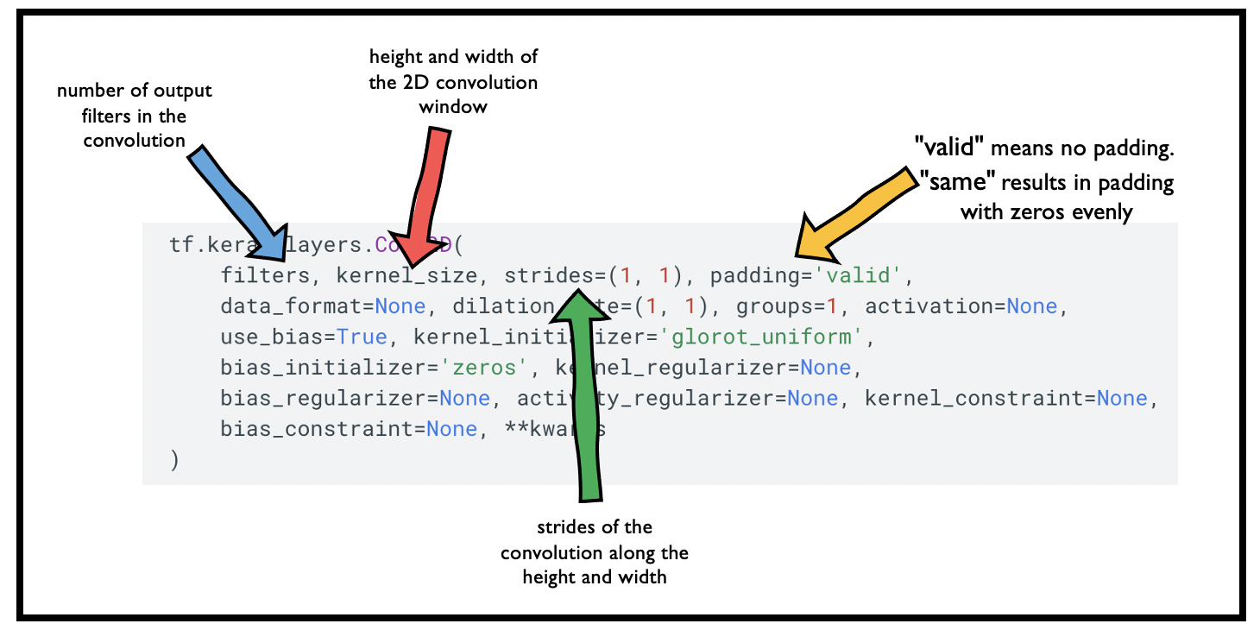
Convolutional layers so far
Multiple parameters to define:
number of filters
size of filters
stride
padding
activation function to use
set the activation. Default activation is ‘linear’

Slide 26
A Convolutional Network
+ ReLU
+ ReLU
What is Pooling?
What is going on here?

Slide 27
Outline
Recap
Training CNNs
What Activation Functions do we use?
What is Pooling?
Dense Layers

Slide 28
Pooling
A pooling layer is a new layer added after the convolutional layer. Specifically, it is added after a nonlinearity (e.g. ReLU) has been applied to the feature maps*.
The pooling layer operates upon each activation map separately to create a new set of the same number of pooled feature maps.
Example:
1 | 1 | 2 | 5
5 | 7 | 7 | 8
3 | 1 | 1 | 0
1 | 2 | 3 | 4
7
max pool with 2x2 window
and stride 2
* Maxpooling could be applied before ReLU.

Slide 29
Pooling
A pooling layer is a new layer added after the convolutional layer. Specifically, it is added after a nonlinearity (e.g. ReLU) has been applied to the feature maps.
The pooling layer operates upon each activation map separately to create a new set of the same number of pooled feature maps.
Example:
1 | 1 | 2 | 5
5 | 7 | 7 | 8
3 | 1 | 1 | 0
1 | 2 | 3 | 4
7 | 8
max pool with 2x2 window
and stride 2

Slide 30
Pooling
A pooling layer is a new layer added after the convolutional layer. Specifically, it is added after a nonlinearity (e.g. ReLU) has been applied to the feature maps.
The pooling layer operates upon each activation map separately to create a new set of the same number of pooled feature maps.
Example:
1 | 1 | 2 | 5
5 | 7 | 7 | 8
3 | 1 | 1 | 0
1 | 2 | 3 | 4
7 | 8
3
max pool with 2x2 window
and stride 2

Slide 31
Pooling
A pooling layer is a new layer added after the convolutional layer. Specifically, it is added after a nonlinearity (e.g. ReLU) has been applied to the feature maps.
The pooling layer operates upon each activation map separately to create a new set of the same number of pooled feature maps.
Example:
1 | 1 | 2 | 5
5 | 7 | 7 | 8
3 | 1 | 1 | 0
1 | 2 | 3 | 4
7 | 8
3 | 4
max pool with 2x2 window
and stride 2

Slide 32
Pooling
A pooling layer is a new layer added after the convolutional layer. Specifically, it is added after a nonlinearity (e.g. ReLU) has been applied to the feature maps*.
The pooling layer operates upon each feature map separately to create a new set of the same number of pooled feature maps.
Pooling involves selecting:
A pooling operation, much like a filter, to be applied to feature maps: e.g. max, mean, median.
The size of the pooling operation.
The stride.
* Maxpooling could be applied before ReLU.

Slide 33
Pooling
Pooling involves selecting:
A pooling operation, much like a filter, to be applied to feature maps: e.g. max, mean, median.
The size of the pooling operation.
The stride.
The size of the pooling operator must be smaller than the size of the feature map; specifically, it is almost always 2×2 applied with a stride of 2 using max pooling.

Slide 34
Pooling
Pooling involves selecting:
A pooling operation, much like a filter, to be applied to feature maps: e.g. max, mean, median.
The size of the pooling operation.
The stride.
The size of the pooling operator must be smaller than the size of the feature map; specifically, it is almost always 2×2 applied with a stride of 2 using max pooling.
Invariant to small, “local transitions”
Face detection: enough to check the presence of eyes, not their precise location
Reduces input size of the final fully connected layers (more later)
No learnable parameters

Slide 35
Pooling: more examples with stride 2x2
1 | 1 | 2 | 5
5 | 7 | 7 | 8
3 | 1 | 1 | 0
1 | 2 | 3 | 4
max pool with 2x2 window
and stride 2x2
7 | 8
3 | 4
1 | 1 | 2 | 5
5 | 7 | 7 | 8
3 | 1 | 1 | 0
1 | 2 | 3 | 4
mean pool with 2x2 window
and stride 2x2
3.5 | 5.5
1.75 | 2

Slide 36
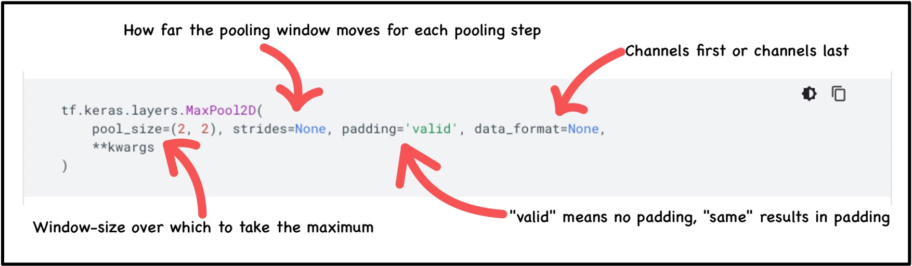
Exercise: Pooling mechanics
The aim of this exercise is to understand the tf.keras implementation of average and max pooling:
implement Max Pooling by building a model with a single MaxPooling2D layer
Next, implement Average Pooling by building a model with a single AvgPooling2D layer
Use the helper code to visualize the output
Use the hint we provide

Slide 37
Outline
Recap
Training CNNs
What Activation Functions do we use?
What is Pooling?
Dense Layers

Slide 38
A Convolutional Network
+ ReLU
Why is there more than one layer?
+ ReLU
What is this square?
What are feature maps and why are there multiple feature maps?
What is going on here?
What is Pooling?

Slide 39
What do CNN layers learn?
Each CNN layer learns features of increasing complexity.

Slide 40
What do CNN layers learn?
Each CNN layer learns features of increasing complexity.
The first layers learn basic feature detection filters: edges, corners, etc.

Slide 41
What do CNN layers learn?
Each CNN layer learns features of increasing complexity.
The first layers learn basic feature detection filters: edges, corners, etc.
The middle layers learn filters that detect parts of objects. For faces, they might learn to respond to eyes, noses, etc.

Slide 42
What do CNN layers learn?
Each CNN layer learns features of increasing complexity.
The first layers learn basic feature detection filters: edges, corners, etc.
The middle layers learn filters that detect parts of objects. For faces, they might learn to respond to eyes, noses, etc.
The last layers have higher representations: they learn to recognize full objects, in different shapes and positions.

Slide 44
Layer 1
Layer 2
CATS
CHAIRS

Slide 45
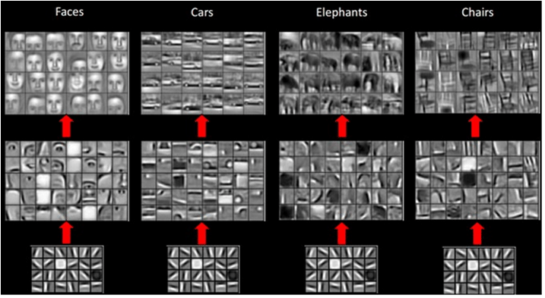

Slide 46
More on this soon

Slide 47
CNN Layers
Flatten
Dense
CATS
…
Flatten
Dense
Layer 1
Layer 2
CATS
…

Slide 48
A Convolutional Network
+ ReLU
+ ReLU
What is going on here?

Slide 49
A Convolutional Network
+ ReLU
+ ReLU

Slide 50
Building a CNN
A convolutional neural network is built by stacking layers, typically of 3 types:
Convolutional Layers
Pooling Layers
Fully connected Layers

Slide 51
Building a CNN
Convolutional Layers
Action
Apply filters to extract features
Filters are composed of small kernels, learned
One bias per filter
Apply activation function on every value of feature map
Parameters
Number of filters
Size of kernels (W and H only, D is defined by input cube)
Activation function
Stride
Padding
I/O
Input: previous set of feature maps: 3D cuboid
Output: 3D cuboid, one 2D map per filter
Pooling Layers
Fully connected Layers

Slide 52
Building a CNN
A convolutional neural network is built by stacking layers, typically of 3 types:
Convolutional Layers
Pooling Layers
Fully connected Layers

Slide 53
Building a CNN
Pooling Layers
Action
Reduce dimensionality
Extract maximum or average of a region
Sliding window approach
Parameters
Stride
Size of window
I/O
Input: previous set of feature maps, 3D cuboid
Output: 3D cuboid, one 2D map per filter, reduced spatial dimensions

Slide 54
Building a CNN
A convolutional neural network is built by stacking layers, typically of 3 types:
Convolutional Layers
Pooling Layers
Fully connected Layers

Slide 55
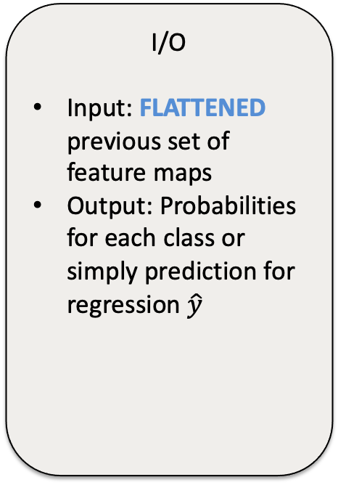
Building a CNN
Fully connected Layers
Action
Aggregate information from final feature maps
Generate final classification, regression, segmentation, etc
Parameters
Number of nodes
Activation function: usually changes depending on role of the layer. If aggregating info, use ReLU. If producing final classification, use Softmax. If regression use linear
I/O
Input: FLATTENED previous set of feature maps
Output: Probabilities for each class or simply prediction for regression $\hat{y}$
Pooling Layers

Slide 56
A Convolutional Network
+ ReLU
+ ReLU

Slide 57
Examples
Let C be a CNN with the following disposition:
Input: 32x32x3 images
Conv1: 8 3x3 filters, stride 1, padding=same
Conv2: 16 5x5 filters, stride 2, padding=same
Flatten layer (explained in the next few slides)
Dense1: 512 nodes
Dense2: 4 nodes
How many parameters does this network have?
Notes:
NEEDS A FIGURE

Slide 58
Input
size=32X32
channels=3
Filter
8 x (size=3X3x3,
stride = 1,
padding = same)
Output
(size=32X32,
channels = 8)
filter x 1
How many parameters does the layer have if I want to use 8 filters?
n_filters x filter_volume + biases = total number of params
8 x (3 x 3 x 3) + 8 = 224

Slide 59
Input
(size=32X32,
channels=8)
Filter
16 x (size=5X5X8,
stride = 2,
padding = same)
Output
(size=16X16,
channels=16)
16 filters
How many parameters does the layer have if I want to use 16 filters?
n_filters x filter_volume + biases = total number of params
16 x (5 x 5 x 8) + 16 = 3216

Slide 60
Input
(size=16X16,
channels=16)
Flatten
(size= 4096)
Fully Connected
(n_nodes=512)
Fully Connected
(n_nodes=4)
How many parameters?
input x FC1_nodes + FC2_nodes = total number of params
(16x16x16) x 512 + 512 + 512 x 4 + 4 = 2,099,716

Slide 61
Examples
Let C be a CNN with the following disposition:
Input: 32x32x3 images
Conv1: 8 3x3 filters, stride 1, padding=same
Conv2: 16 5x5 filters, stride 2, padding=same
Flatten layer (explained in the next few slides)
Dense1: 512 nodes
Dense2: 4 nodes
How many parameters does this network have?
(8 x 3 x 3 x 3 + 8) + (16 x 5 x 5 x 8 + 16) + (16 x 16 x 16 x 512 + 512) + (512 x 4 + 4)
Conv1
Conv2
Dense1
Dense2
Notes:
NEEDS A FIGURE

Slide 62


CS109B GAME Time

Slide 63
Which of the following technique would enable subsampling or down-sampling?
Options
Padding
Dropout
Pooling
Relu Activation

Slide 64
Which of the following technique would enable subsampling or down-sampling?
Options
Padding
Dropout
Pooling
Relu Activation

Slide 65
Given an input of 63x63x16 and you convolve it with 32 filters of size 7x7 with stride 2 and no padding. What are the dimensions of the output volume?
Options
16x16x32
29x29x16
29x29x32
16x29x16

Slide 66
Given an input of 63x63x16 and you convolve it with 32 filters of size 7x7 with stride 2 and no padding. What are the dimensions of the output volume?
Options
16x16x32
29x29x16
29x29x32
16x29x16

Slide 67
Which of the following is a reason for fewer parameters in CNNs as compared to its FFNN counterpart?
Options
A. Shared weights
B. Padding
C. Backpropagation
D. Smaller batch size

Slide 68
Which of the following is a reason for fewer parameters in CNNs as compared to its FFNN counterpart?
Options
A. Shared weights
B. Padding
C. Backpropagation
D. Smaller batch size

Slide 69
es = EarlyStopping(monitor='val_acc', patience=10, verbose=1) The benefits of using the Keras callback above during fitting include:?
Options
Preventing Unnecessary Resource Expenditure (time & compute)
Reduce Overfitting
C. Returns model with best validation accuracy
D. A & B
E. B & C

Slide 70
es = EarlyStopping(monitor='val_acc', patience=10, verbose=1) The benefits of using the Keras callback above during fitting include:?
Options
Preventing Unnecessary Resource Expenditure (time & compute)
Reduce Overfitting
C. Returns model with best validation accuracy
D. A & B
E. B & C

Slide 71
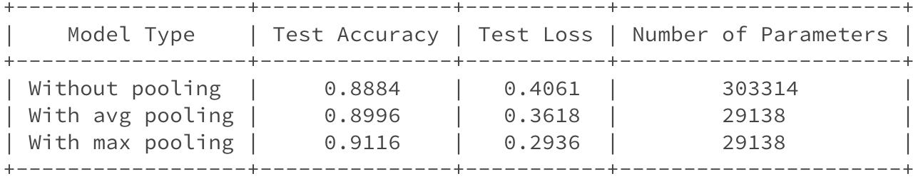
Exercise: Performance measure
The aim of this exercise is to compare average and max pooling by measuring accuracy and number of parameters for the classification of MNIST digits
Build three MNIST classification models, one with no pooling, one with average pooling, and one with max pooling, and train them with similar hyper-parameters
Compute the number of parameters and the accuracy on the test set for each model

